Slide 1
Cryptocurrency exchange
Requirements & Design

Slide 2

Presentation plan
Business context
User stories
Architecture
Implementation list

Slide 3

Business task
Exchange one currency for another
Get fee for every deal
Provide more services for more deals

Slide 4
User stories
User can sign up -> notify
User can deposit in any currency -> notify
User can create order -> order will be executed
User can see history action
User can get notifications

Slide 5
Solution

Slide 6
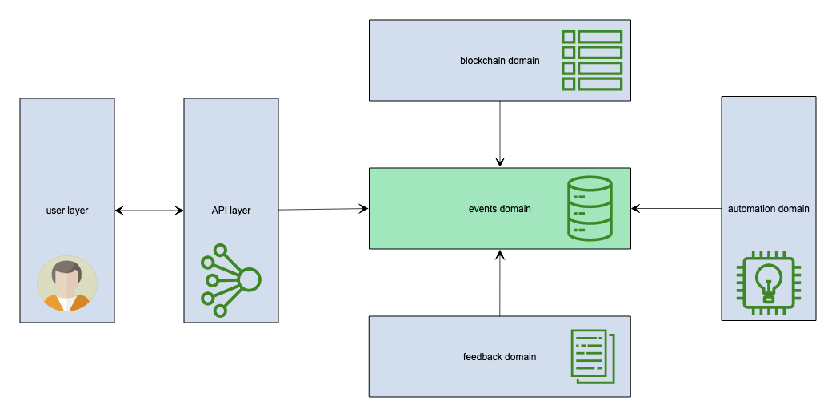
High level system arch

Slide 7
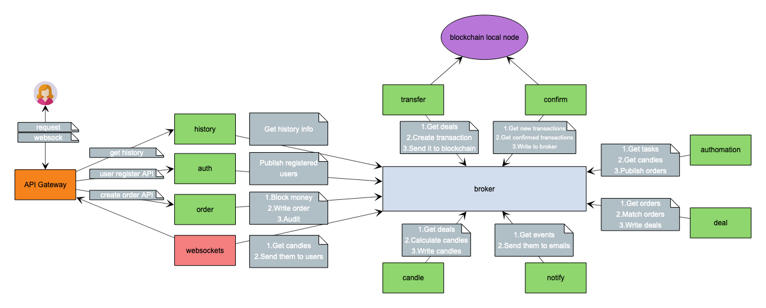
System layer arch in real live

Slide 8
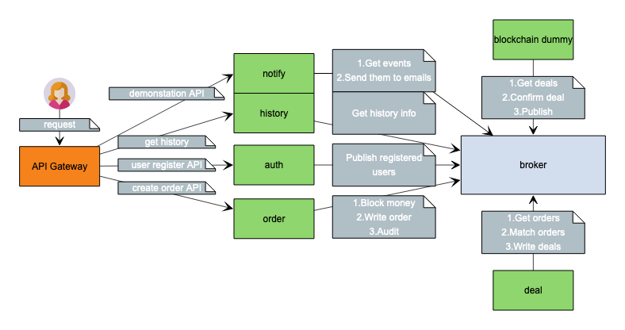
Implementation
Mockups
Services
Grafana dashboards
Demo via postman tests

Slide 9
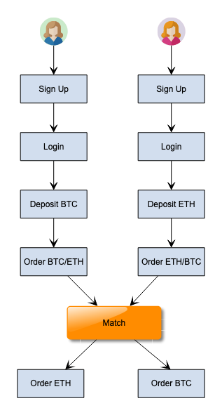
User order pipeline
Deposit BTC:
Wallet creation
Send transaction
or USD exchange

Slide 10
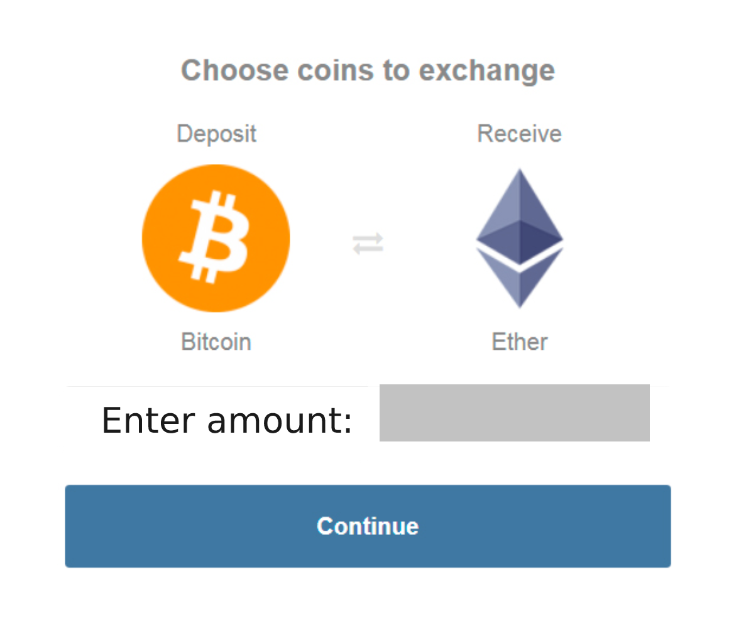
Order mockup

Slide 11
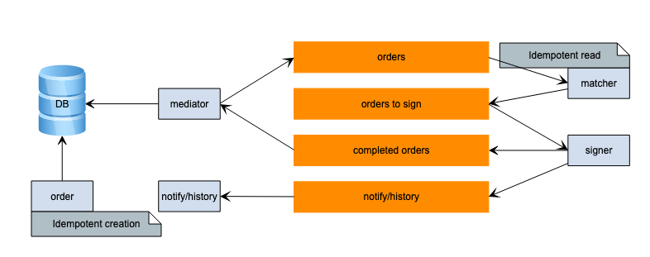
Order pipeline & problems
Mediator order duplication
Matcher down OR fail

Slide 12
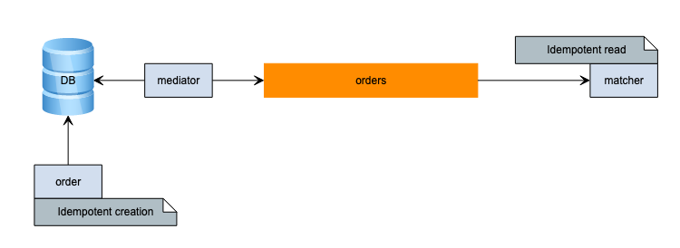
Patterns
API Gateway
Event collaboration
Idempotent order creation
Transactional outbox
Long term saga ready

Slide 13
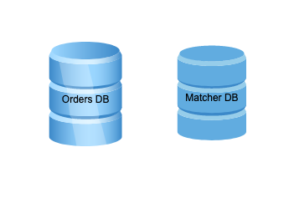
Scale ways
Shards with balancing
AP database - weak consistency (Cassandra/Riak)
CP - Redis
VMware ha cluster

Slide 14
DEMO

Slide 15
Thank you!

